Slide 1



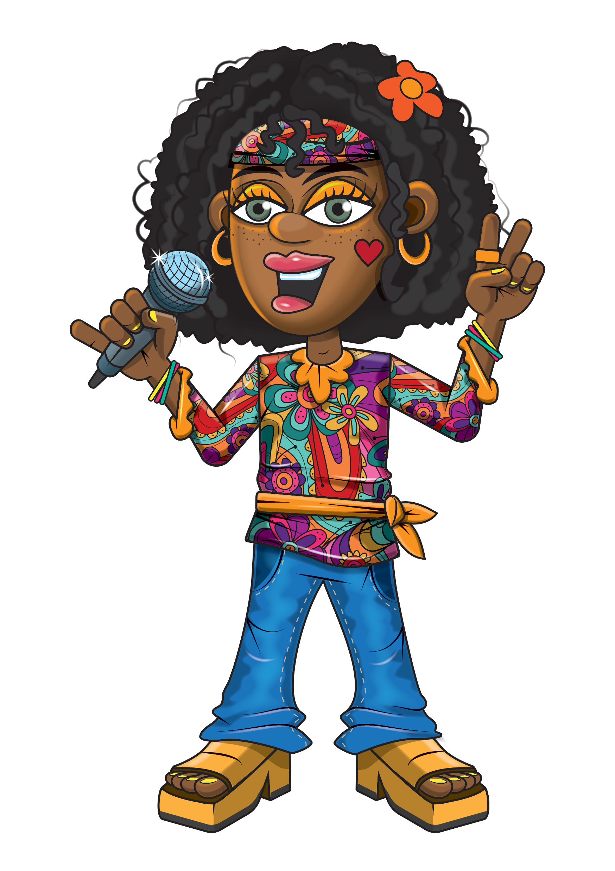


Slide 2
Warm-up
8, 16, 24, 32, 40
48, 56, 64, 72, 80
88, 96

Slide 3
Let’s rock and roll the 8s!

Slide 4
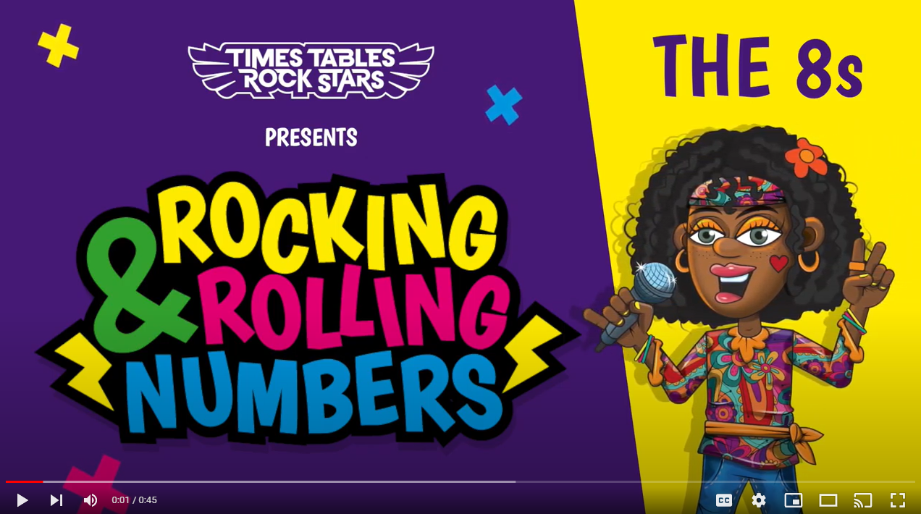
Continue with the lyrics in PowerPoint.
or
Play video

Slide 5
(The next 2 slides are the intro that you use for all tables in the ‘Rocking and Rolling Numbers’ series.)

Slide 6


Intro
Are you ready?
Ready for what?
Are you ready?
We’re ready to rock!

Slide 7

Intro
How do you want to rock today?
We’re ready to rock in an 8s kind of way!
Wooooooooooooaaaaaaaaaaaaahhhhhhh!!!
Notes:
Note that in the class’ line “We’re ready to rock in a ___ kind of way!” you’ll need to change that number to whichever table you’re rocking and rolling today.

Slide 8
(And now we get into the lyrics for this particular table.)

Slide 9
The 8s
Let’s groove the 8 times table.

Slide 10
The 8s
8, 16, 24.
32 and 40.

Slide 11
The 8s
48 and 56.
64 and 72.

Slide 12
The 10s
80.
88 and 96.

Slide 13
The 8s
We just smashed the 8s…like this.

Slide 14
(You’ve got to the end!)

Slide 15
(On the next slide, you’ve got all the lyrics in one place in case you’d prefer to see it all together.)

Slide 16
Intro
The 8s
Are you ready?
Ready for what?
Are you ready?
We’re ready to rock!
How do you want to rock today?
We’re ready to rock in an 8s kind of way!
Woooooooooaaaaaaahhh!
Let’s groove the 8 times table!
8, 16, 24.
32 and 40.
48 and 56.
64 and 72.
80!
88 and 96.
We just smashed the
8s like this!

