Slide 1

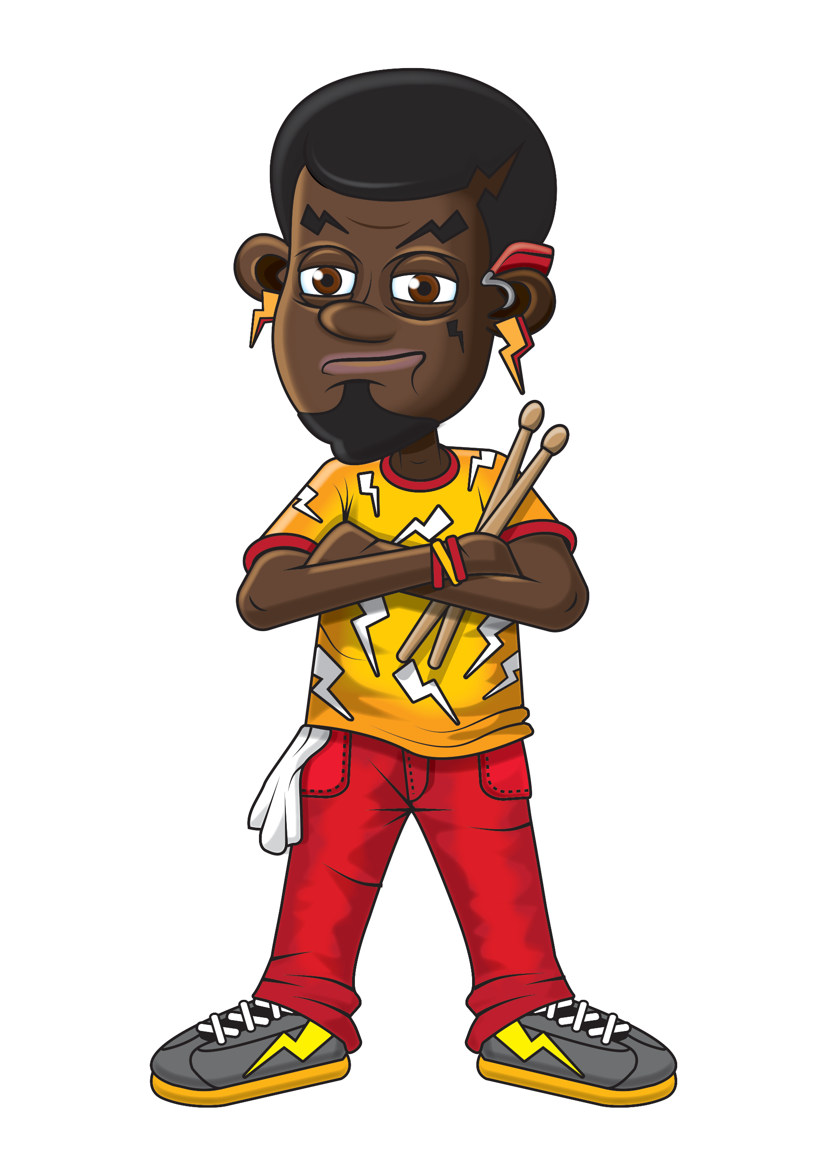




Slide 2
Warm-up
4, 8, 12, 16, 20,
24, 28, 32, 36, 40,
44, 48.

Slide 3
Let’s rock and roll the 4s!

Slide 4
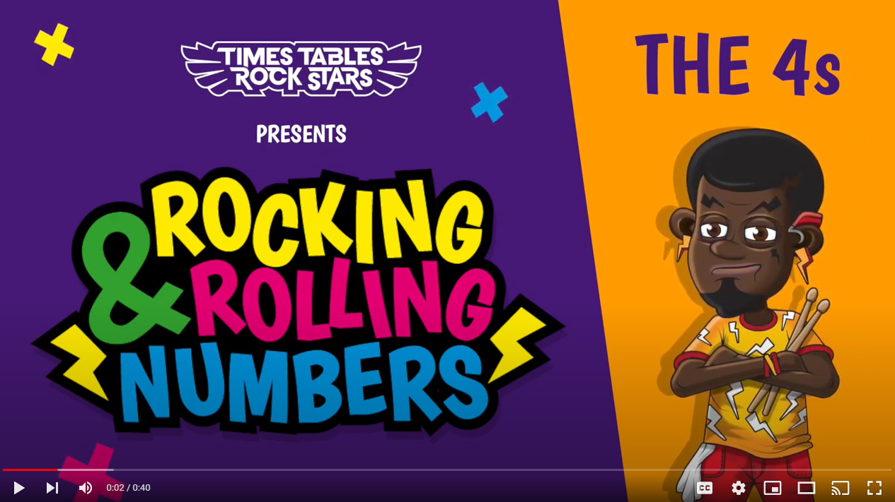
Continue with the lyrics in PowerPoint.
or
Play video

Slide 5
(The next 2 slides are the intro that you use for all tables in the ‘Rocking and Rolling Numbers’ series.)

Slide 6


Intro
Are you ready?
Ready for what?
Are you ready?
We’re ready to rock!

Slide 7

Intro
How do you want to rock today?
We’re ready to rock in a 4s kind of way!
Wooooooooooooaaaaaaaaaaaaahhhhhhh!!!
Notes:
Note that in the class’ line “We’re ready to rock in a ___ kind of way!” you’ll need to change that number to whichever table you’re rocking and rolling today.

Slide 8
(And now we get into the lyrics for this particular table.)

Slide 9
The 4s
4, 8.
12, 16.

Slide 10
The 4s
This is how we rock the 4s.

Slide 11
The 4s
20.
24, 28.
32, 36 and Forrrrrrty.

Slide 12
The 4s
44 to the left..
48 to the right…

Slide 13
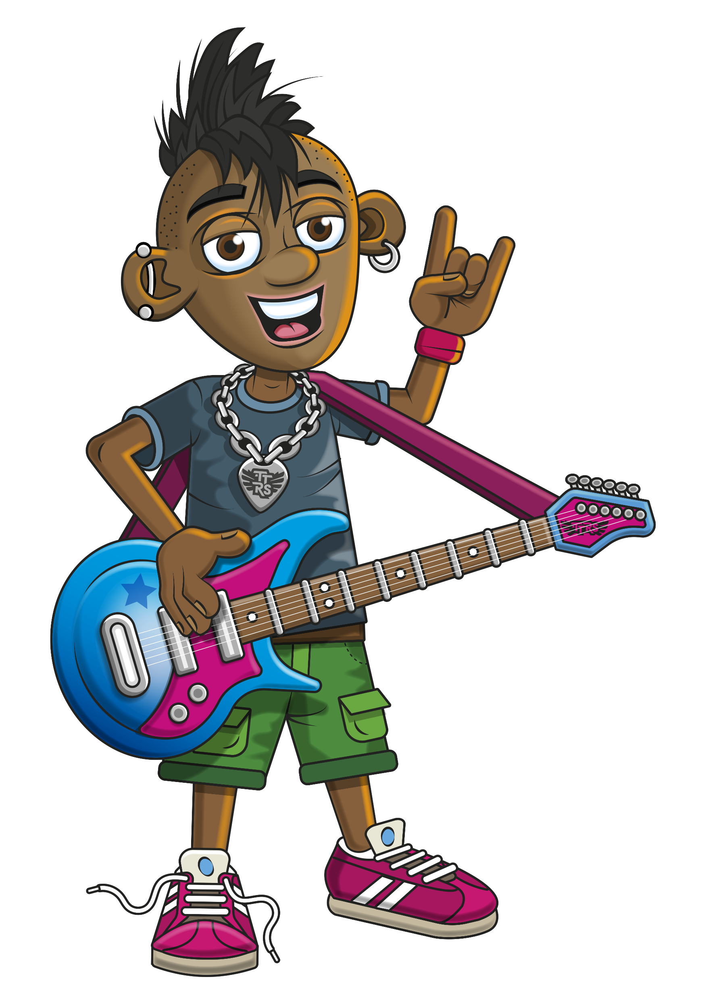
The 4s
Spark rocks the 4s.

Slide 14
The 4s
All day and night…

Slide 15
(You’ve got to the end!)

Slide 16
(On the next slide, you’ve got all the lyrics in one place in case you’d prefer to see it all together.)

Slide 17
Intro
The 4s
Are you ready?
Ready for what?
Are you ready?
We’re ready to rock!
How do you want to rock today?
We’re ready to rock in a 4s kind of way!
Woooooooooaaaaaaahhh!
4, 8.
12, 16.
This is how we rock the 4s.
20.
24, 28.
32, 36 and forrrrrrty.
44 to the left.
48 to the right.
Spark rocks the 4s.
All day and night.

