Slide 1



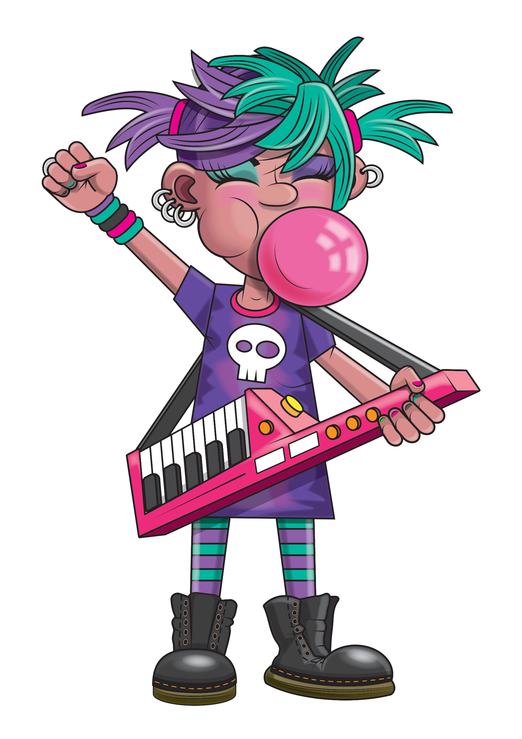


Slide 2
Warm-up
3, 6, 9, 12, 15,
18, 21, 24, 27, 30,
33, 36

Slide 3
Let’s rock and roll the 3s!

Slide 4
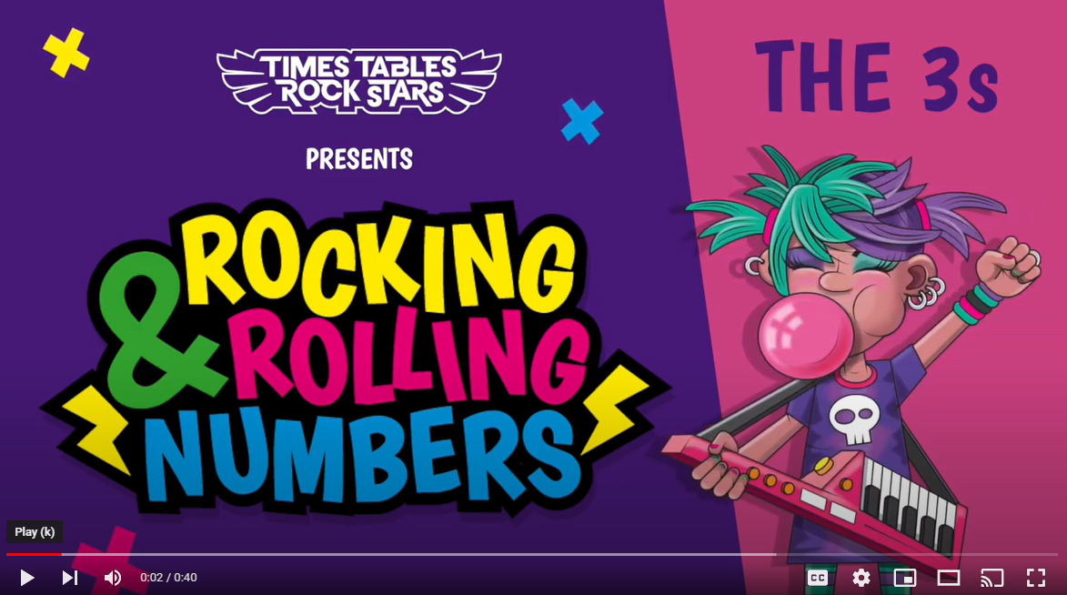
Continue with the lyrics in PowerPoint.
or
Play video

Slide 5
(The next 2 slides are the intro that you use for all tables in the ‘Rocking and Rolling Numbers’ series.)

Slide 6


Intro
Are you ready?
Ready for what?
Are you ready?
We’re ready to rock!

Slide 7

Intro
How do you want to rock today?
We’re ready to rock in a 3s kind of way!
Wooooooooooooaaaaaaaaaaaaahhhhhhh!!!
Notes:
Note that in the class’ line “We’re ready to rock in a ___ kind of way!” you’ll need to change that number to whichever table you’re rocking and rolling today.

Slide 8
(And now we get into the lyrics for this particular table.)

Slide 9
The 3s
3, 6, 9.

Slide 10
The 3s
12, 15, 18.

Slide 11
The 3s
Key change!

Slide 12
The 3s
21, 24, 27.

Slide 13
The 3s
30, 33, 36.

Slide 14
The 3s
Just like that we played the keys.

Slide 15
The 3s
Now that’s a wrap,
We smashed the 3s!

Slide 16
(You’ve got to the end!)

Slide 17
(On the next slide, you’ve got all the lyrics in one place in case you’d prefer to see it all together.)

Slide 18
Intro
The 3s
Are you ready?
Ready for what?
Are you ready?
We’re ready to rock!
How do you want to rock today?
We’re ready to rock in a 3s kind of way!
Woooooooooaaaaaaahhh!
3, 6, 9,
12, 15, 18.
Key change!
21, 24, 27,
30, 33, 36.
Just like that we played
the keys.
Now that’s a wrap,
We smashed the 3s!

