Slide 1



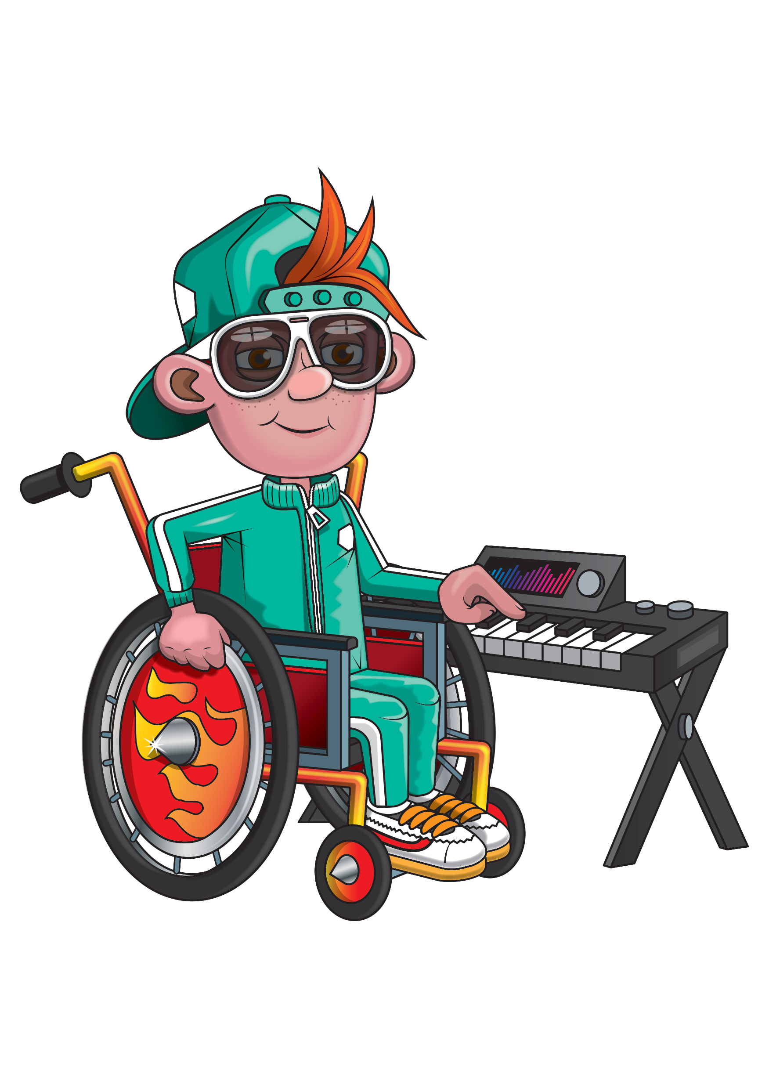
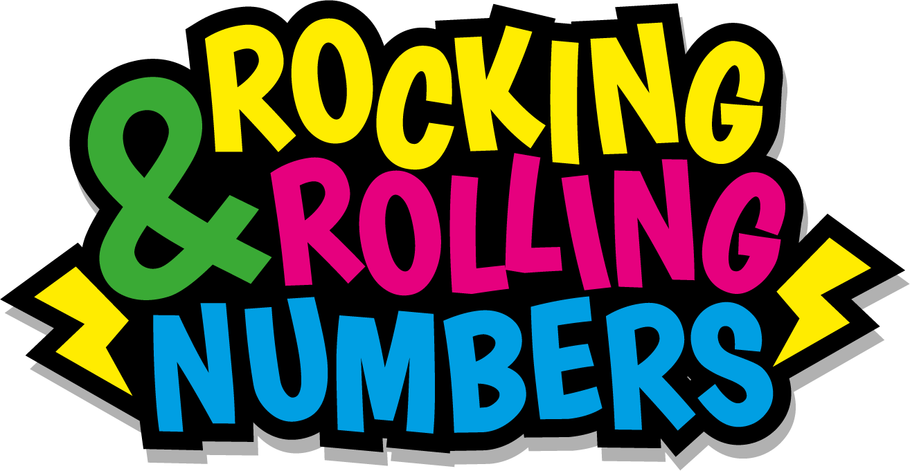

Slide 2
Warm-up
2, 4, 6, 8, 10,
12, 14, 16, 18,
20, 22, 24.

Slide 3
Let’s rock and roll the 2s!

Slide 4
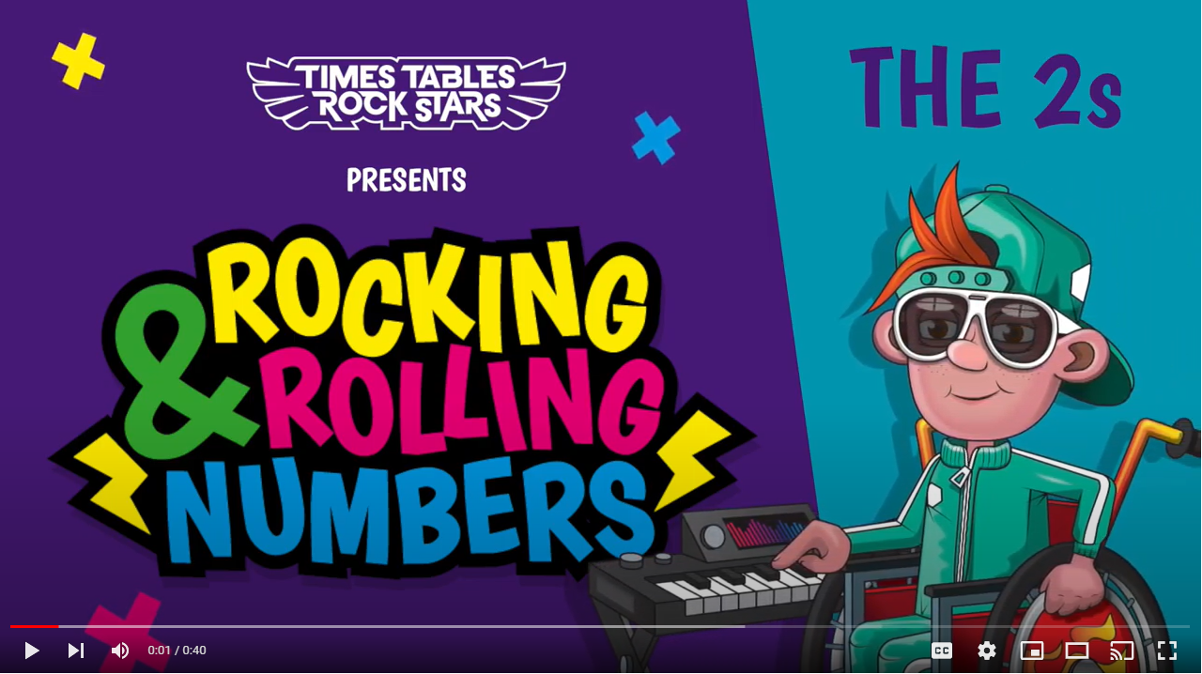
Continue with the lyrics in PowerPoint.
or
Play video

Slide 5
(The next 2 slides are the intro that you use for all tables in the ‘Rocking and Rolling Numbers’ series.)

Slide 6


Intro
Are you ready?
Ready for what?
Are you ready?
We’re ready to rock!

Slide 7

Intro
How do you want to rock today?
We’re ready to rock in a 2s kind of way!
Wooooooooooooaaaaaaaaaaaaahhhhhhh!!!
Notes:
Note that in the class’ line “We’re ready to rock in a ___ kind of way!” you’ll need to change that number to whichever table you’re rocking and rolling today.

Slide 8
(And now we get into the lyrics for this particular table.)

Slide 9
The 2s
2 to the 4
To the 6
To the 8.

Slide 10
The 2s
Look to the side
High five a mate!

Slide 11
The 2s
10 to the 12,
14, 16.

Slide 12
The 2s
Rock like a Boss,
Roll like Springsteen.

Slide 13
The 2s
18, 20,
22, 24.

Slide 14
The 2s
Now we’re vibin’
Leave ‘em wanting more…

Slide 15
(You’ve got to the end!)

Slide 16
(On the next slide, you’ve got all the lyrics in one place in case you’d prefer to see it all together.)

Slide 17
Intro
The 2s
Are you ready?
Ready for what?
Are you ready?
We’re ready to rock!
How do you want to rock today?
We’re ready to rock in a 2s kind of way!
Woooooooooaaaaaaahhh!
2 to the 4 to the 6 to the 8.
Look to the side,
High five a mate!
10 to the 12 to the 14, 16.
Rock like a Boss.
Roll like Springsteen!
18, 20, 22, 24.
Now we’re vibin’
Leave ‘em wanting
more…

